Slide 1
Engineering Data Science
Christian Cabrera
University of Cambridge
06/11/2024
Notes:
Good morning, I am Christian Cabrera one of the course lecturers. Today we are going to see how Data Science projects can be engineered. Why is that important and what approaches can be used for this? We will also revise how you can use these engineering approaches or tools during the practical work of this course but most importantly in any data science project your carry out.

Slide 2
Previously…
Data Science Challenges
Notes:
In the previous lectures with Neil, you heard about the challenges that Data Science projects face. People in general have several concerns about these challenges. Data scientists are responsible for providing solutions or strategies that address these challenges in diverse domains.

Slide 3

Previously…
Data Science Challenges
Bias
Systematic tendency in which methods used to gather data and compute statistics generate inaccurate depictions of reality.
Source: https://mlatcl.github.io/advds/lectures/04-02-ai-and-data-science.html
Challenges our ability to deploy safe and effective solutions:
Alignment
Fairness
Inclusiveness
Notes:
Bias was one of the concepts you heard about in the previous lecture. Statistical bias is a systematic tendency in which the methods used to gather data and generate statistics create an inaccurate depiction of reality. Bias is present in all data management processes we perform in data science and there are different types of Bias. We can have selection bias when our data samples do not represent the population we are studying, historical bias when the data reflects historic social and cultural beliefs, algorithmic bias when an algorithm produces systematic and repeatable errors that generate unfair outcomes and many more. It is quite difficult to avoid Bias in any data science project, so the best we can do is to learn how to identify them.

Slide 4
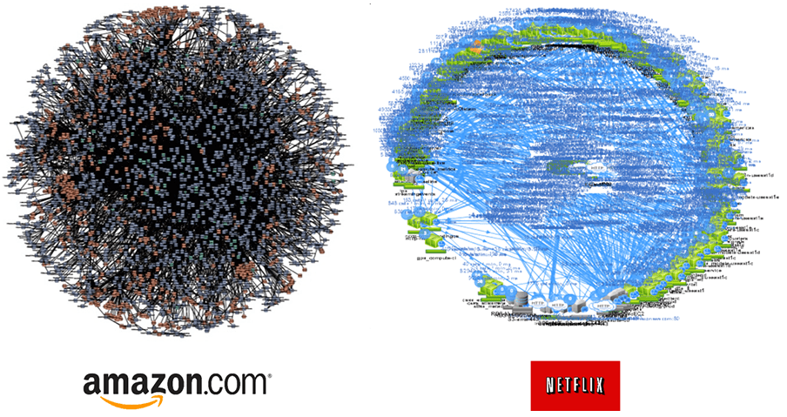

Previously…
Data Science Challenges
Complexity
Systems are highly dynamic and have grown in size. The data processing pipelines involve hundreds or thousands of components.
Source: https://www.divante.com/blog/10-companies-that-implemented-the-microservice-architecture-and-paved-the-way-for-others
Challenges our technical ability to deploy and maintain our solutions:
Sustainability
Maintainability
Notes:
Systems are more complex and data pipelines too
Sustainability from different perspectives: Individual sustainability, social sustainability, economic sustainability, and environmental sustainability.

Slide 5
Previously…
Data Science Challenges
Intellectual Debt
Black-box components make systems hard to understand and threaten human control. We know they components work but do not know how.
Source: (Zittrain-2019) https://medium.com/berkman-klein-center/from-technical-debt-to-intellectual-debt-in-ai-e05ac56a502c
Challenges our ability to explain our solutions:
Interpretability
Accountability
Notes:
- We must design data pipelines that keep humans in control despite their complexity.

Slide 6

Why are these important?
Data Science Challenges
Bias
Complexity
Intellectual Debt
…
Source: https://www.freepik.com/free-photos-vectors/society
Notes:
- This list of challenges is far from complete. But the question is why are the Data Science challenges important?

Slide 7
Why are these important?
Society has challenging problems…
Alignment
Inclusiveness
Interpretability
Fairness
Sustainability
Accountability
Maintainability
Source: https://www.freepik.com/free-photos-vectors/society

Slide 8

How do we build solutions now?
Focus on technology
Notes:
In contrast to how society has different requirements, we mostly focus on the technology when developing our solutions…

Slide 9
How do we build solutions now?
Focus on technology
For example, we have a learning model that generates predictions from inputs:
Learning Model
<inputs>
<prediction>

Slide 10
How do we build solutions now?
Focus on technology
For example, we have a learning model that generates predictions from inputs:
Learning Model
<inputs>
<prediction>
Learning Model | Accuracy
Model v1 | 88%
Model v2 | 90%
Model v3 | 98%
More capable models
Larger models
Powerful infrastructure
Promising applications

Slide 11
How do we build solutions now?
Focus on technology
For example, we have a learning model that generates predictions from inputs:
Learning Model
<inputs>
<prediction>
Learning Model | Accuracy
Model v1 | 88%
Model v2 | 90%
Model v3 | 98%
Does Model v3 address end users’ requirements?

Slide 12
Real-world Deployments
Context matters
Learning Model
<inputs>
<prediction>

Slide 13
Real-world Deployments
Context matters
System
Learning models are deployed as part of larger systems.
Systems address end users’ requirements.
Users' requirements must drive the design of the systems.
Component 1
Learning Model
User’s
Request
Component 4
System’s
Outputs
Component 2
Component 3

Slide 14
Real-world Deployments
Context matters
System
Systems are composed of multiple components
These components can impact the behavior of the learning models
Component 1
<inputs>
Learning Model
User’s
Request
<inputs>
Component 4
System’s
Outputs
Component 2
Component 3

Slide 15
Real-world Deployments
Context matters
Learning models outputs can be inputs for other components
Systems’ outputs are aggregations of the data processed by different components.
System
Component 1
<inputs>
Learning Model
<prediction>
User’s
Request
<inputs>
Component 4
System’s
Outputs
Component 2
Component 3

Slide 16
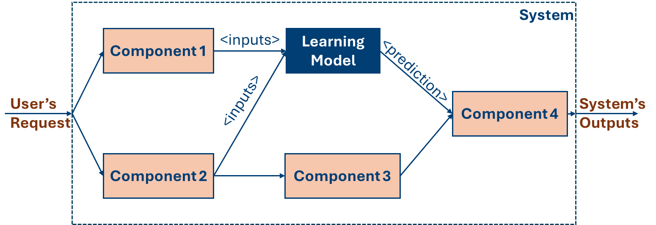
Real-world Deployments
Context matters
* Low latency requirement!
(< 5secs)
Learning Model | Accuracy | Latency
Modelv1 | 88% | 3 secs
Modelv2 | 90% | 4 secs
Modelv3 | 98% | 10 secs

Slide 17
Real-world Deployments
Context matters
* Low latency requirement!
(< 5secs)
*Constraint resources.
Learning Model | Accuracy | Latency | Resources Demand
Modelv1 | 88% | 3 secs | Low
Modelv2 | 90% | 4 secs | Medium
Modelv3 | 98% | 10 secs | High

Slide 18


Context
What do people need?
What are the social problems data science can help with?
Source: https://commons.wikimedia.org/wiki/File:NP_coffee_cooperative_%285867722870%29.jpg
Source: https://www.flickr.com/photos/scottishgovernment/23657582298/in/photostream/

Slide 19
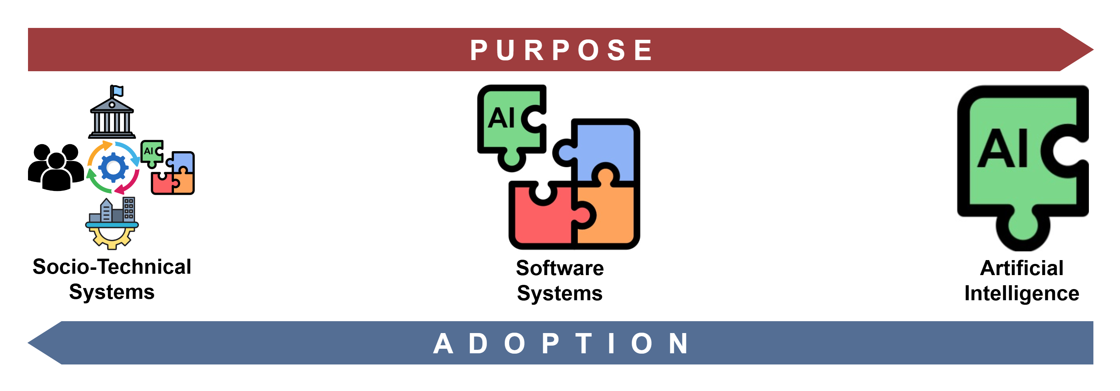
Technology Adoption

Slide 20
Technology Adoption

Slide 21
Technology Adoption

Slide 22
Technology Adoption

Slide 23
How do we engineer software systems?
The Systems Engineering Approach
Problem first
Why is this problem important?
What are the people needs?
Which are the problem constraints?
What are the important variables to consider?
…

Slide 24
How do we engineer software systems?
The Systems Engineering Approach
Engineering Principles
Systems Thinking
Process Model
Notes:
We use these principles implicitly in our daily activities. But we need an explicit application of such principles and that is one of the goals of the systems engineering approach.

Slide 25
How do we engineer software systems?
Systems Thinking
System Views: Defining problems from different perspectives.
Agility System: Defining flexible systems architectures.
System Dynamics: Modelling the changing nature of systems.

Slide 26
How do we engineer software systems?
Process Model
Top-Down Analysis: Divide and conquer. Problem decomposition.
Variant Creation: Assessing different alternatives to solve a problem.
Problem-Solving Cycle: Defining and following a methodology.

Slide 27
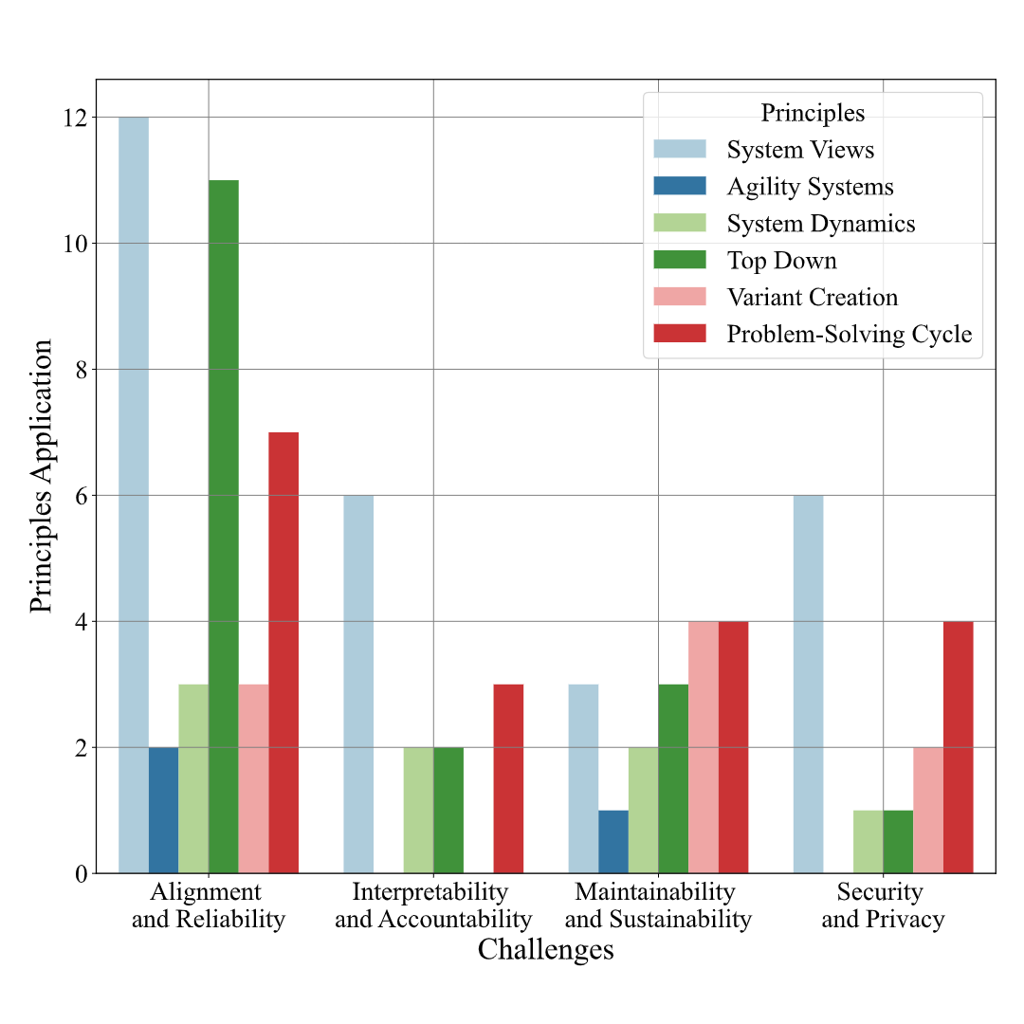
Systems Engineering Principles in Practice
A survey of 24 works that apply the principles to address when deploying AI-based Systems:
Alignment and Reliability
Interpretability and Accountability
Maintainability and Sustainability
Security and Privacy
Cabrera, Christian, Bastidas Viviana, Schooling Jennifer, and Neil David Lawrence. “The Systems Engineering Approach in Times of Large Language Models." Proceedings of the 58th Hawaii International Conference on System Sciences 2025. (To appear)

Slide 28
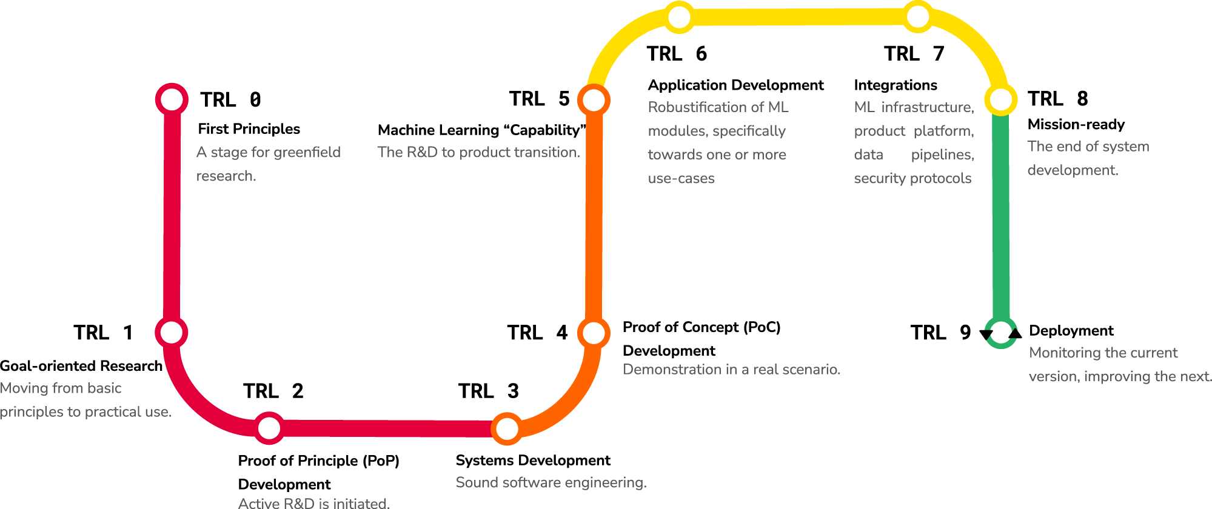
Systems Engineering Principles in Practice
MLTRL – Technology readiness levels for machine learning systems
Domain: Critical Systems
Alignment and reliability, interpretability and accountability, maintainability and sustainability, and security and privacy.
Lavin, A., Gilligan-Lee, C.M., Visnjic, A. et al. Technology readiness levels for machine learning systems. Nat Commun 13, 6039 (2022). https://doi.org/10.1038/s41467-022-33128-9

Slide 29
Systems Engineering Principles in Practice
System Views.
Variant Creation.
Lavin, A., Gilligan-Lee, C.M., Visnjic, A. et al. Technology readiness levels for machine learning systems. Nat Commun 13, 6039 (2022). https://doi.org/10.1038/s41467-022-33128-9

Slide 30
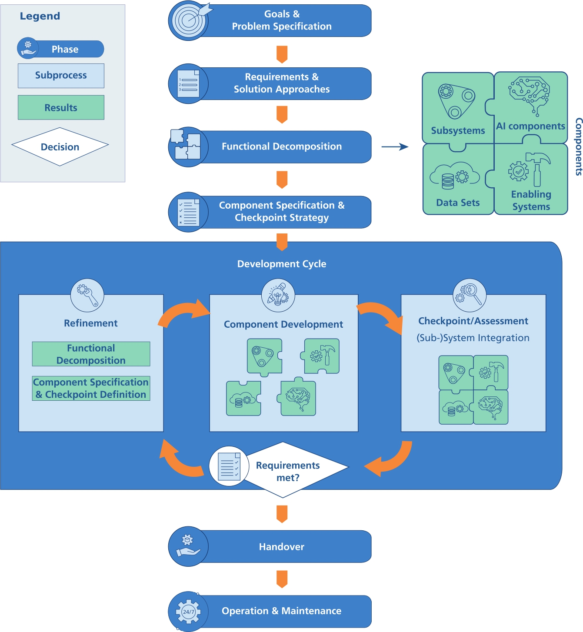
Systems Engineering Principles in Practice
PAISE® – Process Model for AI Systems Engineering
Domain: ML-based Systems
Alignment and reliability:
Problem Solving Cycle.
Top-Down Analysis.
System Views.
Agility Systems.
Hasterok, Constanze and Stompe, Janina. "PAISE® – process model for AI systems engineering" at - Automatisierungstechnik 70, no. 9 (2022): 777-786. https://doi.org/10.1515/auto-2022-0020

Slide 31
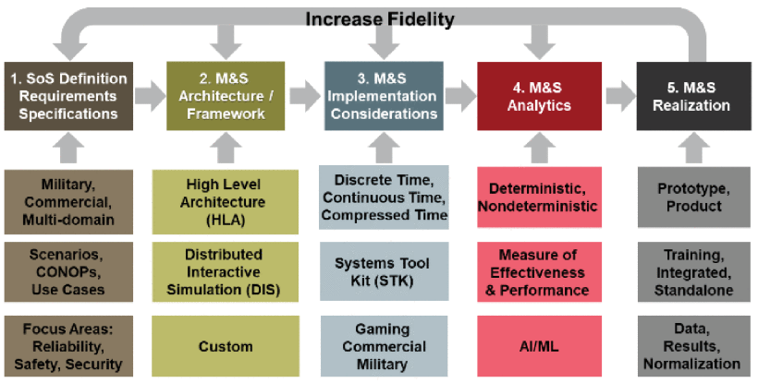
Systems Engineering Principles in Practice
ACDANS – System of Systems Engineering Approach for Complex Deterministic and Nondeterministic Systems
Domain: Military Systems
Problem Solving Cycle.
System Dynamics
Variant Creation.
Alignment and reliability, maintainability and sustainability, and security and privacy.
P. Hershey, "System of Systems Engineering Approach for Complex Deterministic and Nondeterministic Systems (ACDANS)," 2021 16th International Conference of System of Systems Engineering (SoSE), Västerås, Sweden, 2021, pp. 185-190, doi: 10.1109/SOSE52739.2021.9497496.

Slide 32
Engineering Data Science
Data Problem
Data Pipeline

Slide 33
Data Problem
Understanding stakeholders’ needs
Understanding resources and constraints
Understanding data sources
Understanding the nature of the data

Slide 34
Data Problem
Systems Thinking
Understanding stakeholders’ needs
Understanding resources and constraints
Understanding data sources
Understanding the nature of the data
Different points of view: city council, landlord, tenants.
Agility Systems: Flexible resources (e.g., cloud database), and flexible architecture (i.e., library).
Dynamic Systems: Heterogeneous data, temporal features, spatial data, etc.

Slide 35
Data Pipeline
The Fynesse framework:
Access
Assess
Address

Slide 36
Data Pipeline
Process Model
The Fynesse framework:
Access
Assess
Address
Top-down: downloading and uploading data chunks.
Variant creation: exploring different data sources and management strategies.
Problem-solving cycle: access, assess, and address loop.

Slide 37
Engineering Data Science
Assess
Access
Address

Slide 38
Engineering Data Science
Assess
Access
Address

Slide 39
Engineering Data Science
DS Library
Assess
Access
Address

Slide 40


Engineering Data Science
ADS Library
Assess
Access
Address

Slide 41
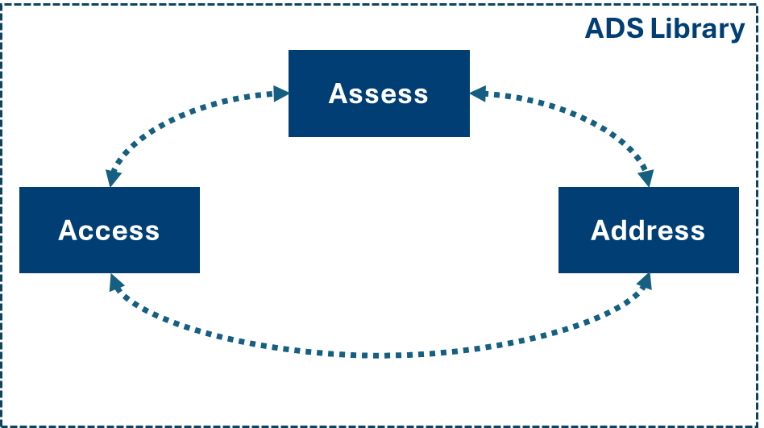
Engineering Data Science
- Data from UK citizens and infrastructure.
- gov.UK and institutions managing data.
- Open Street Maps (OSM).
Learning models

Slide 42
Summary
Context is important when addressing Data Science challenges.
We must address these challenges because Data science projects impact people.
The Systems Engineering approach provides principles to guide our work.
We should include these principles in our Data Science projects.

Slide 43
Many thanks!

